Slide 1
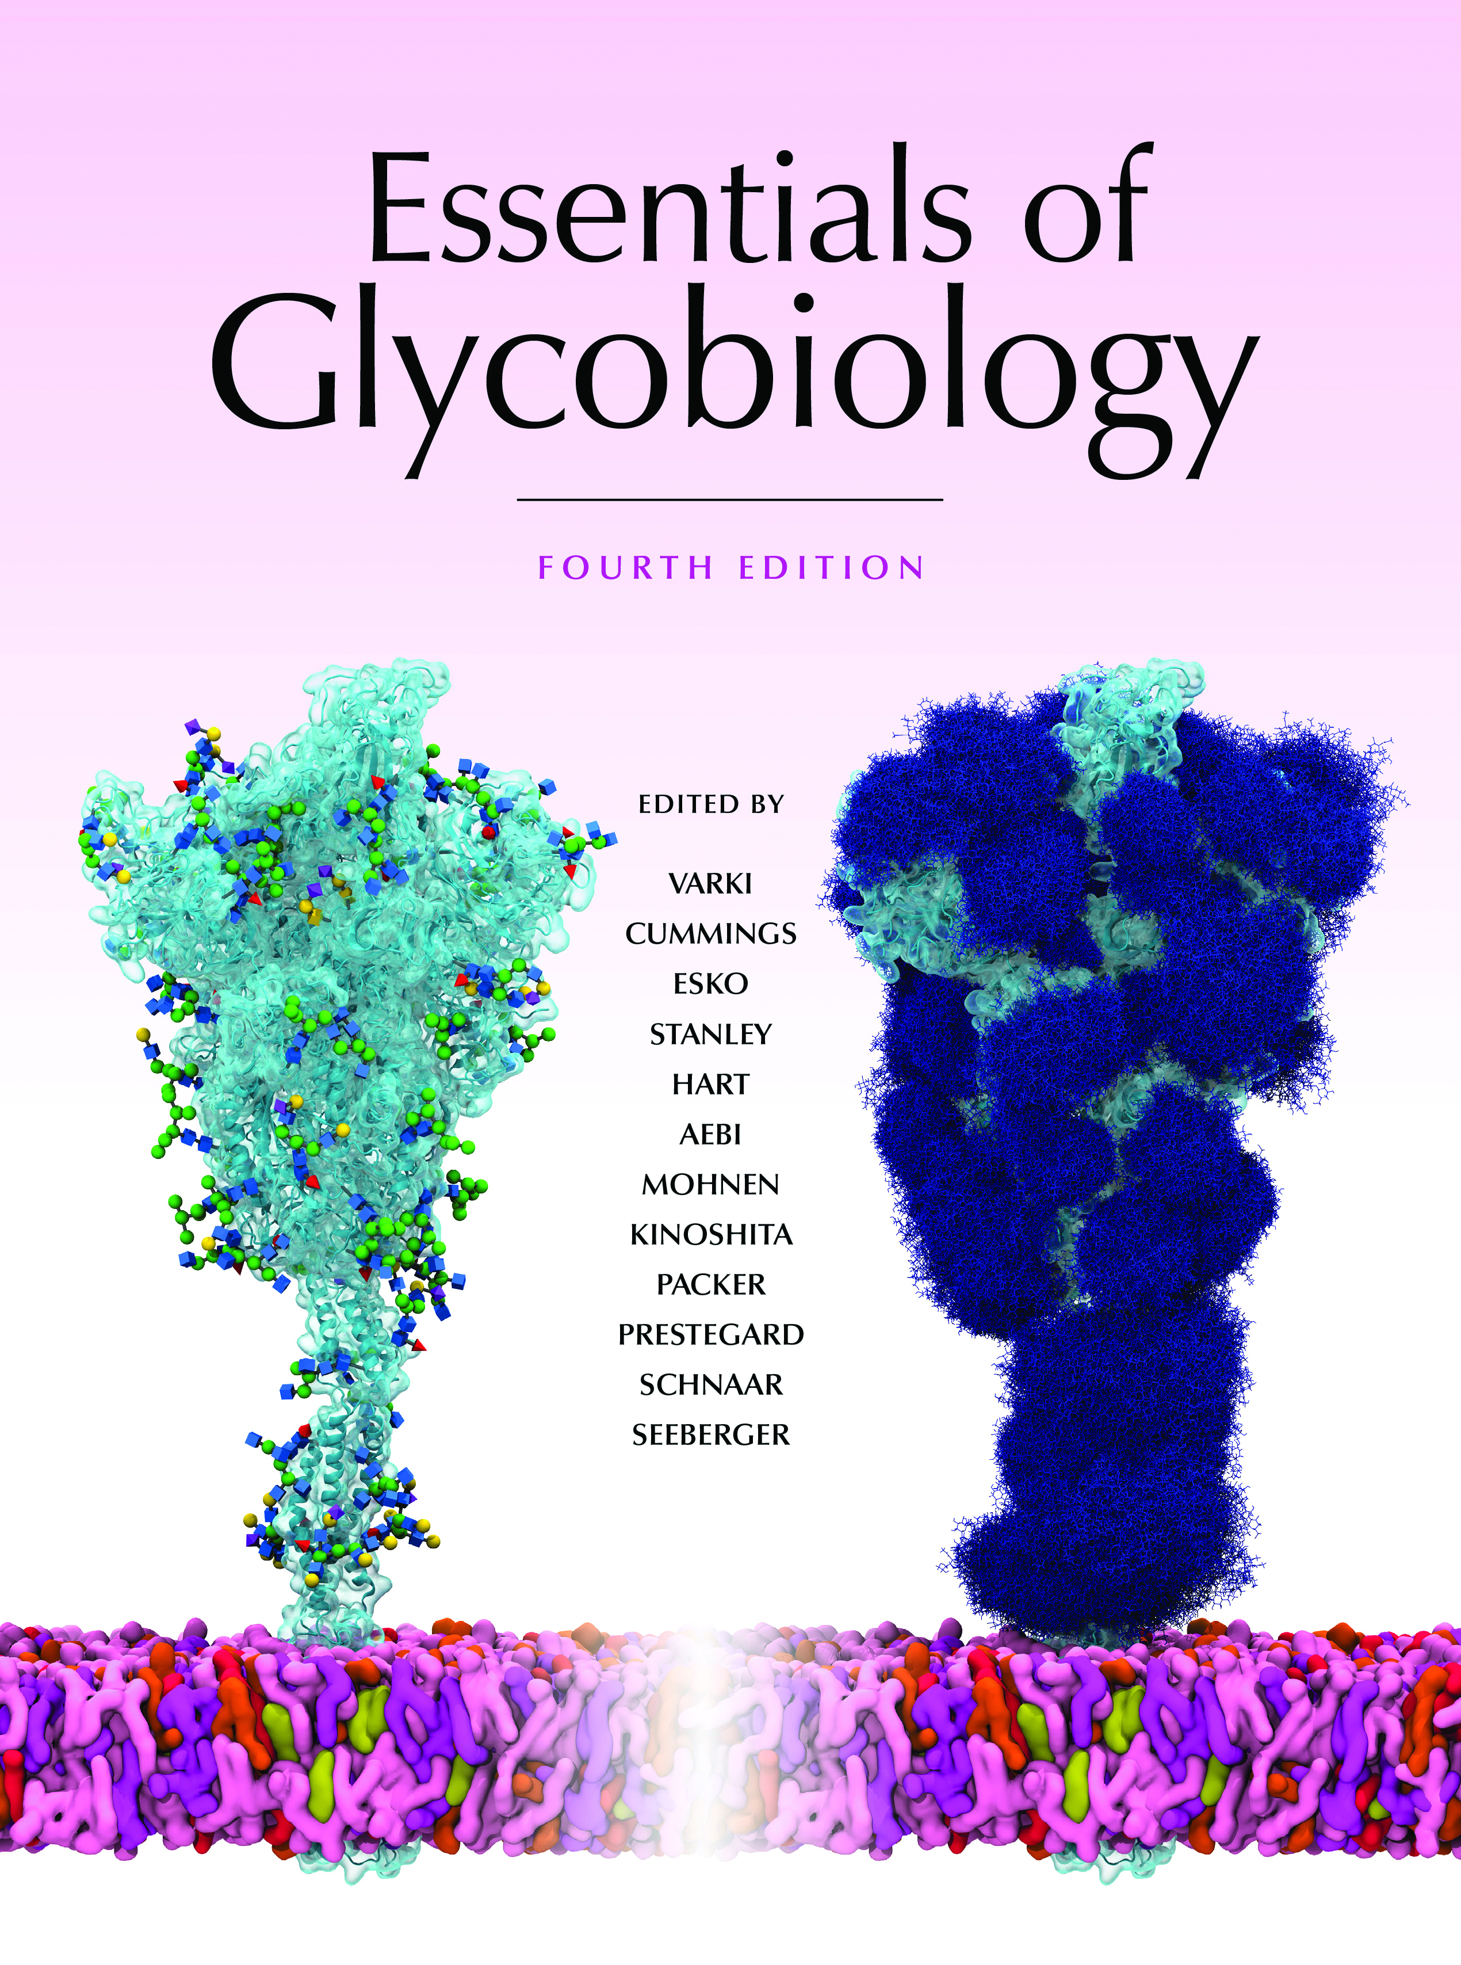


Features of GPI-Anchored Proteins
Chapter 12, Figure 4. Essentials of Glycobiology, Fourth Edition
Click here for Symbol Nomenclature for Glycans (SNFG)
(Live only in slide display mode)
Buy the Book
©2022 The Consortium of Glycobiology Editors, La Jolla, California
Notes:
(Note: Embedded links are present but live only in the slide display mode.)
FIGURE 12.4. (A) Features of glycosylphosphatidylinositol (GPI)-anchored proteins and their processing by GPI transamidase. GPI-anchored proteins have an amino-terminal signal peptide for translocation into the ER and a carboxy-terminal GPI-addition signal peptide (top) that is removed and directly replaced by a GPI precursor (bottom). (B) Examples of carboxy-terminal sequences signaling the addition of GPI anchors.

