Slide 1
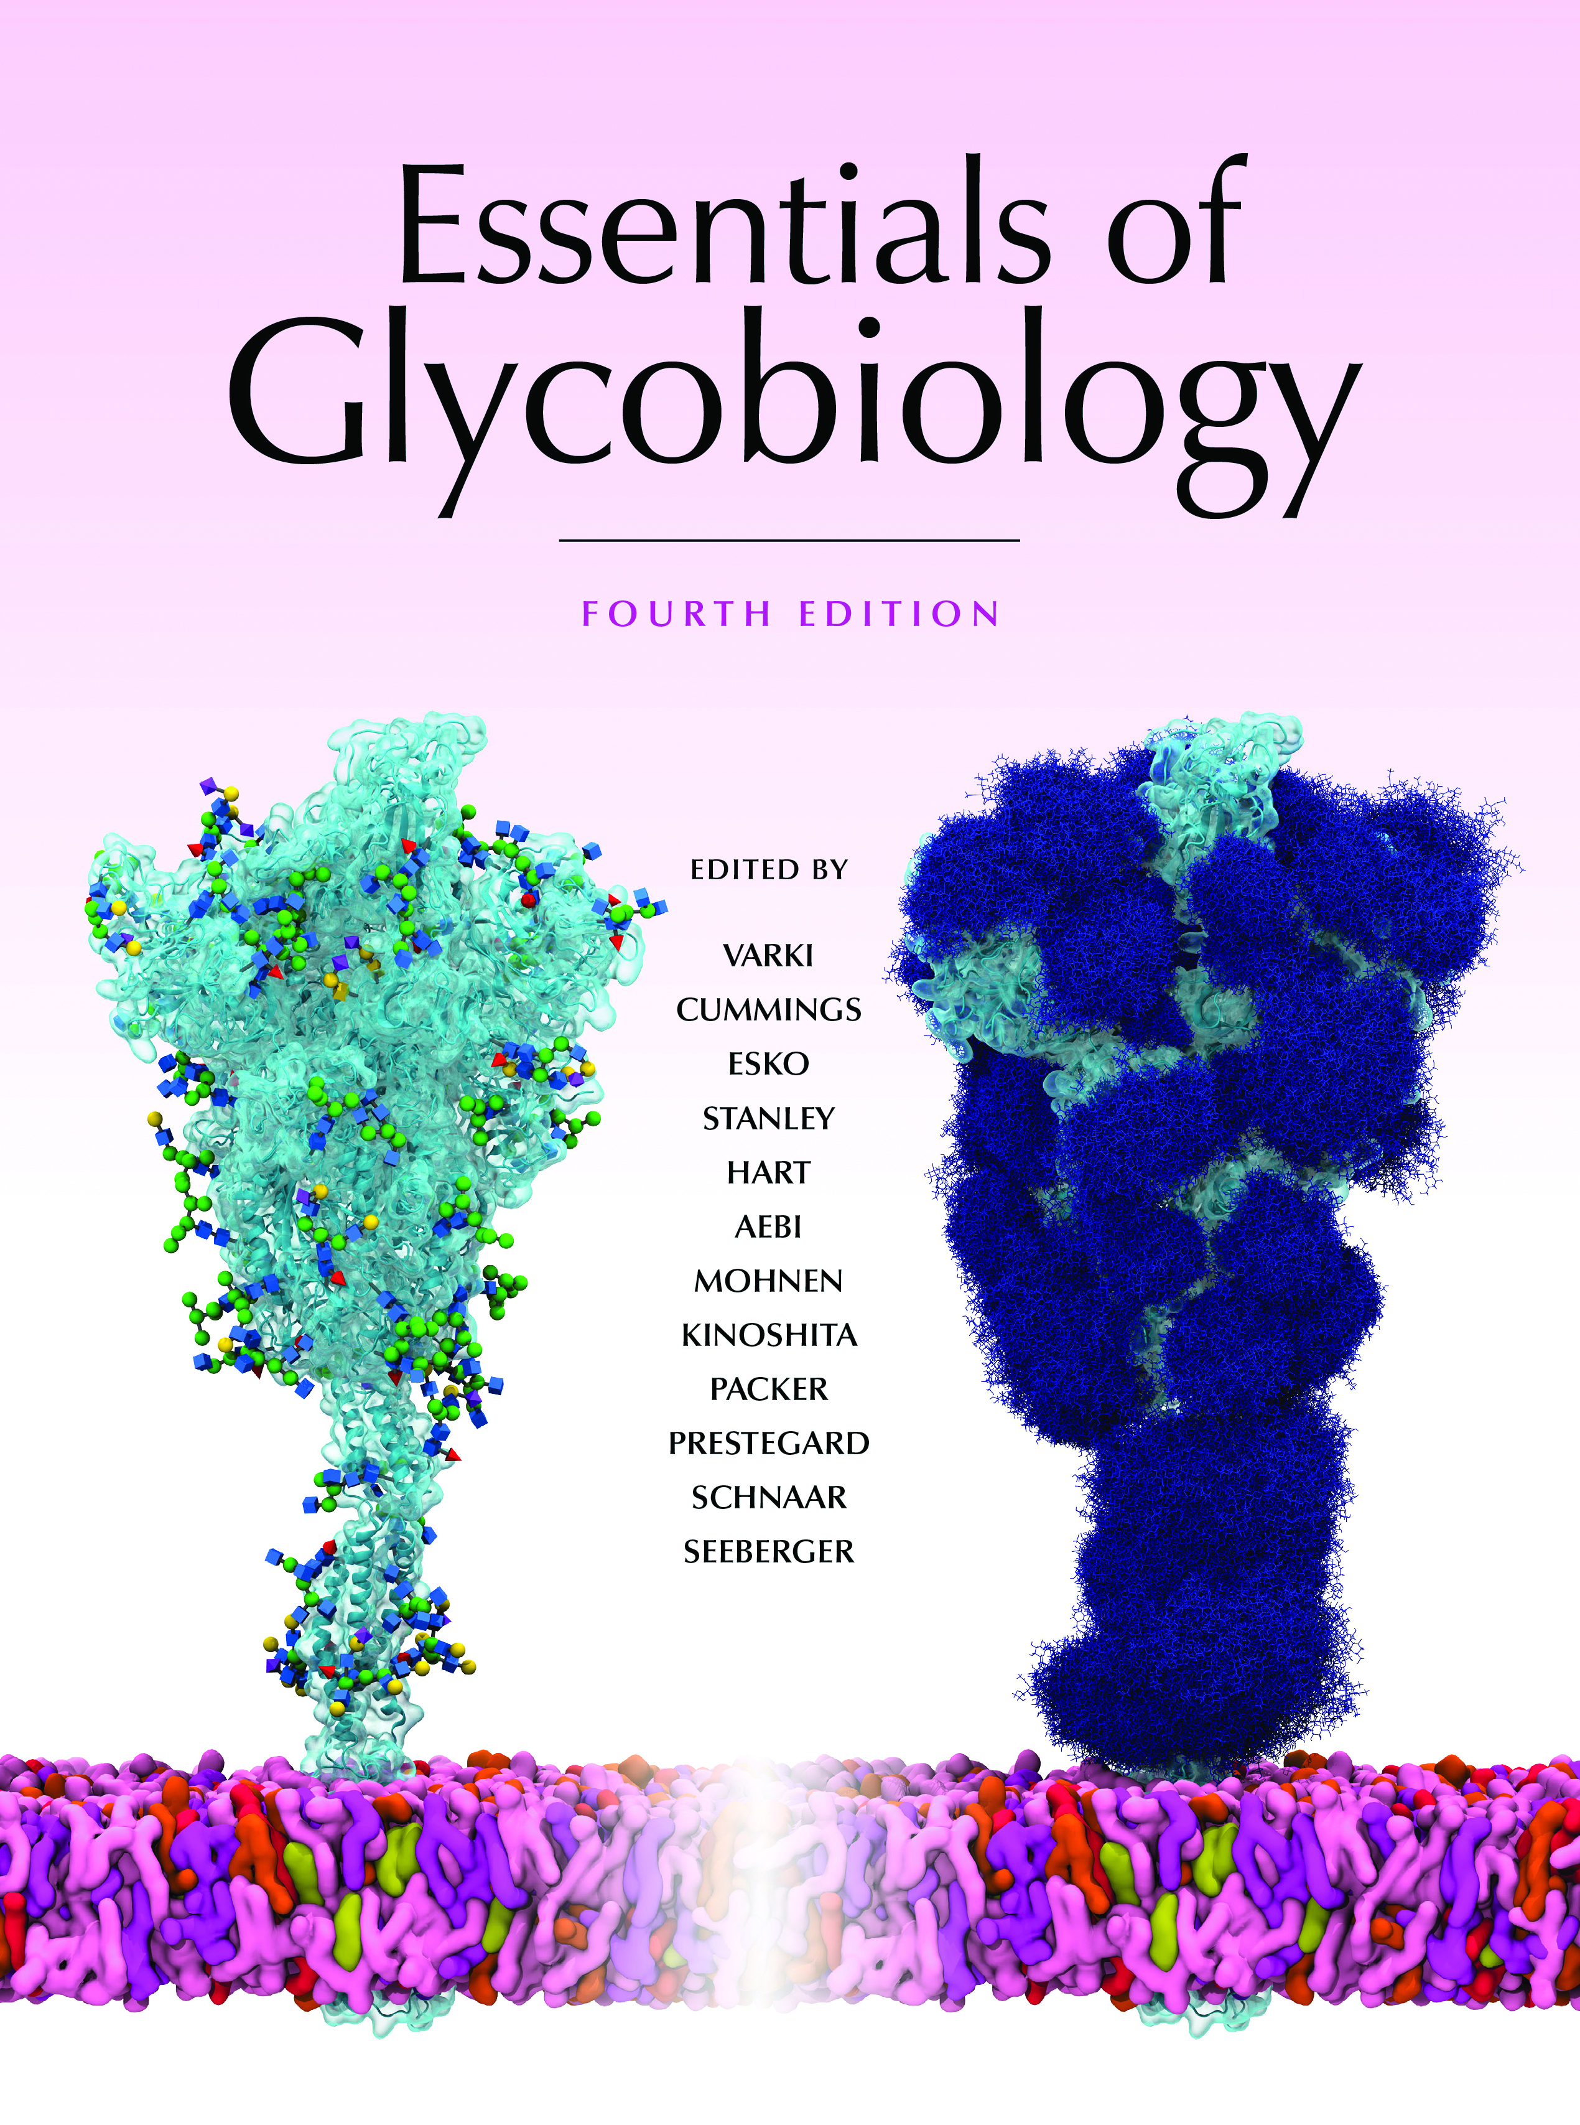
Predicted Topologies of the ER-Resident Components of GPI Biosynthesis in Mammalian Cells
Chapter 12, Figure 3. Essentials of Glycobiology, Fourth Edition
Buy the Book
©2022 The Consortium of Glycobiology Editors, La Jolla, California
Notes:
(Note: Embedded links are present but live only in the slide display mode.)
FIGURE 12.3. Predicted topologies of the ER-resident components of glycosylphosphatidylinositol (GPI) biosynthesis in mammalian cells. Components within boxes belong to multisubunit complexes. The step numbers refer to those in Figure 12.2 and Table 12.1. The topologies of the "multispanning" membrane proteins are mostly those predicted by bioinformatics methods. N, amino terminus; ER, endoplasmic reticulum.

