Slide 1
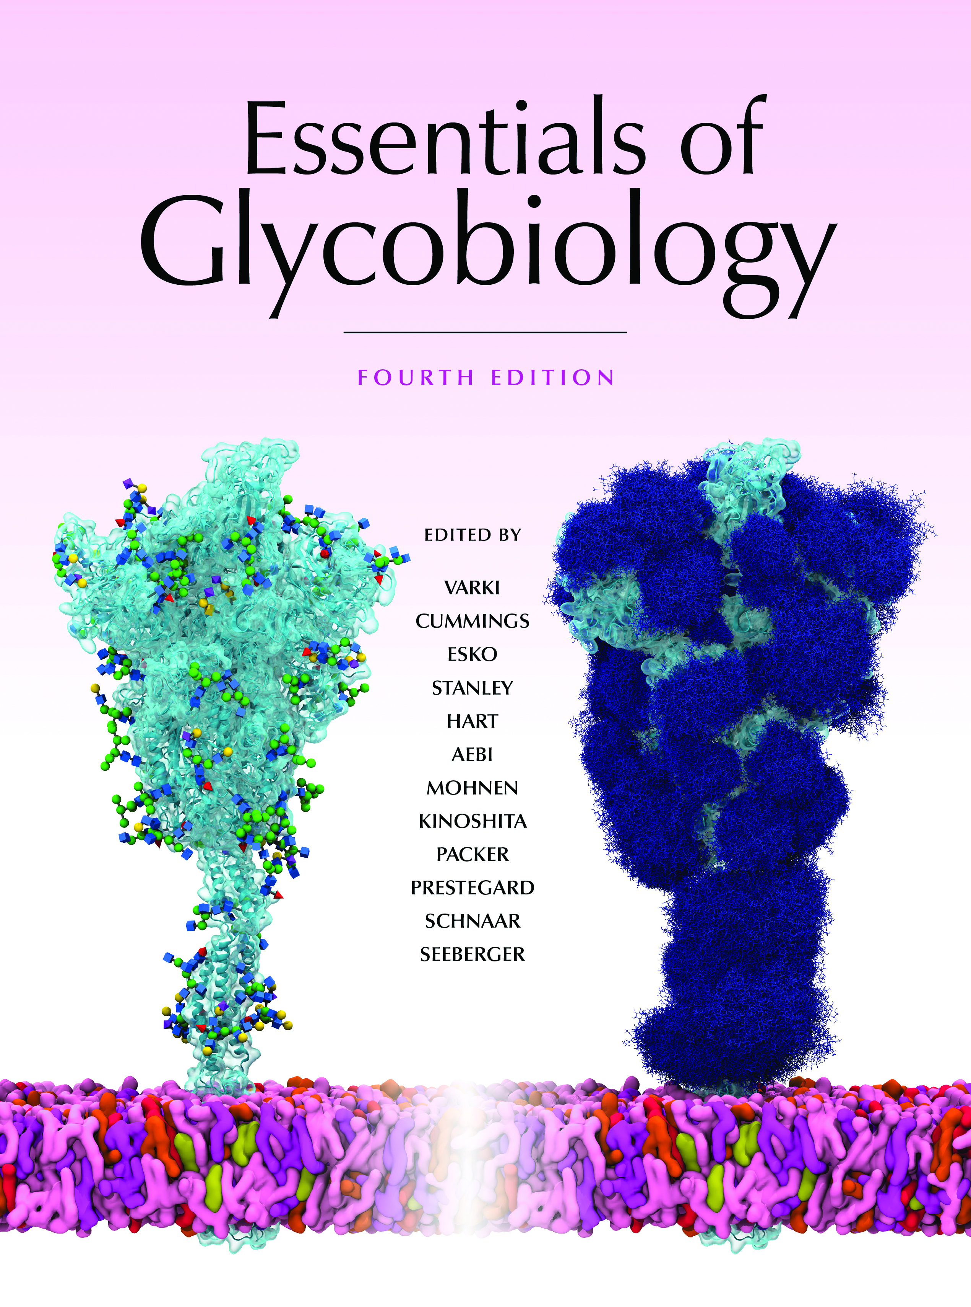
GPI-Biosynthetic Pathways
Chapter 12, Figure 2. Essentials of Glycobiology, Fourth Edition
Buy the Book
©2022 The Consortium of Glycobiology Editors, La Jolla, California
Notes:
(Note: Embedded links are present but live only in the slide display mode.)
FIGURE 12.2. Glycosylphosphatidylinositol (GPI)-biosynthetic pathways of Trypanosoma brucei, Saccharomyces cerevisiae, and mammals. These examples show that, despite the highly conserved core structure of GPI anchors, some diversity in GPI-biosynthesis exists. In particular, yeast and mammalian GPI intermediates are inositol-acylated at the level of GlcN-PI and are not deacylated until after transfer to protein, whereas T. brucei GPI intermediates are acylated at the level of Man-GlcN-PI and undergo rounds of deacylation and reacylation throughout the pathway. Mammalian GPI intermediates undergo a first round of lipid remodeling at the level of GlcN-aPI and then again after transport to the Golgi. S. cerevisiae GPI intermediates have a compulsory Man-4 added unlike in mammals and lipid remodeling of their GPI-APs occur in two consecutive steps within the endoplasmic reticulum (ER). The protein components of the pathway that catalyze these steps in mammals and S. cerevisiae are described in Table 12.1. Some of the T. brucei homologs are yet to be identified. The "?" refers to an unknown process. The double-headed arrows represent flipping of the GPI intermediate by an unknown mechanism. Dashed arrows denote probable alternative pathways or steps that are not compulsory.

