Slide 1
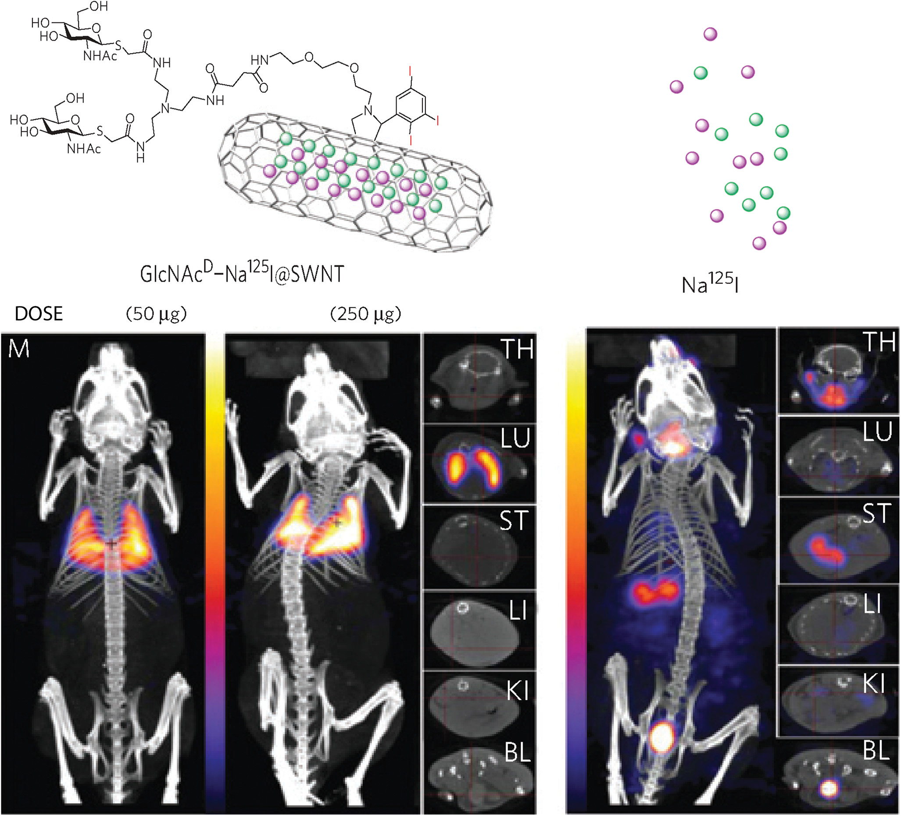
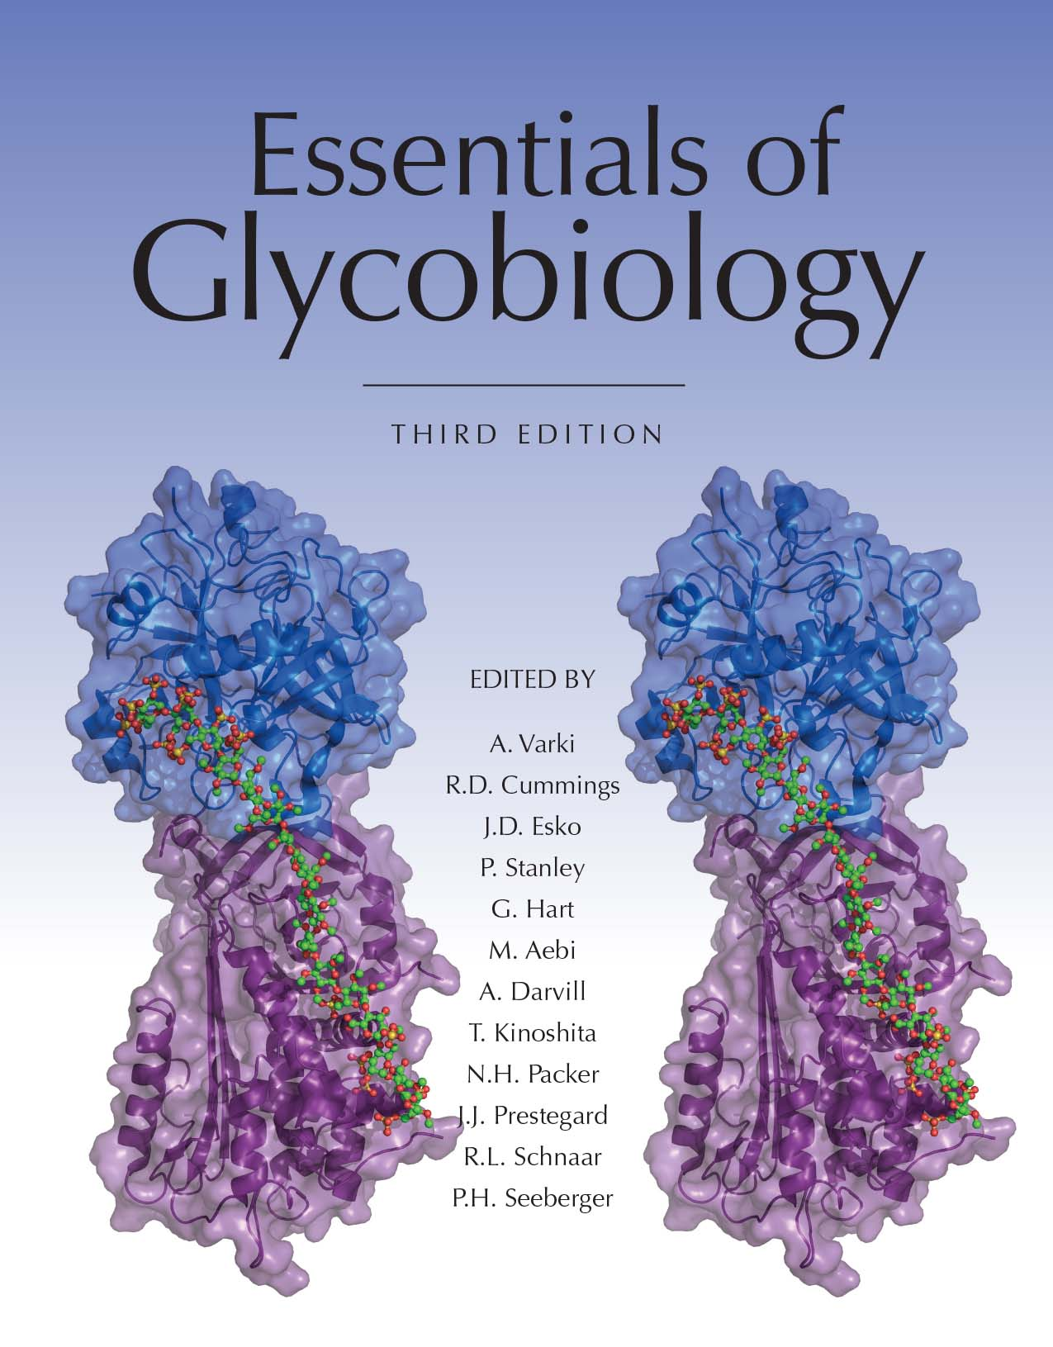
In Vivo Localization of Filled-and-Functionalized Glyco-Single-Walled Nanotubules
Chapter 58, Figure 4. Essentials of Glycobiology, Third Edition
Buy the Book
©2017 The Consortium of Glycobiology Editors, La Jolla, California
Notes:
FIGURE 58.4. In vivo localization of filled-and-functionalized glyco-single-walled nanotubules (SWNTs). (TH) thyroid; (LU) lungs; (ST) stomach; (LI) liver; (KI) kidney; (BL) bladder. (Adapted from Hong SY, et al. 2010. Nat Mater 9: 485−490. Original art has been adapted and redrawn by R.D. Cummings.)
(Note: Embedded links are present but live only in the slide display mode.)

