Slide 1
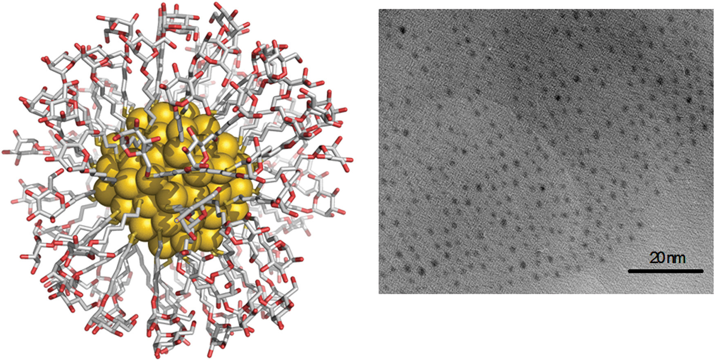
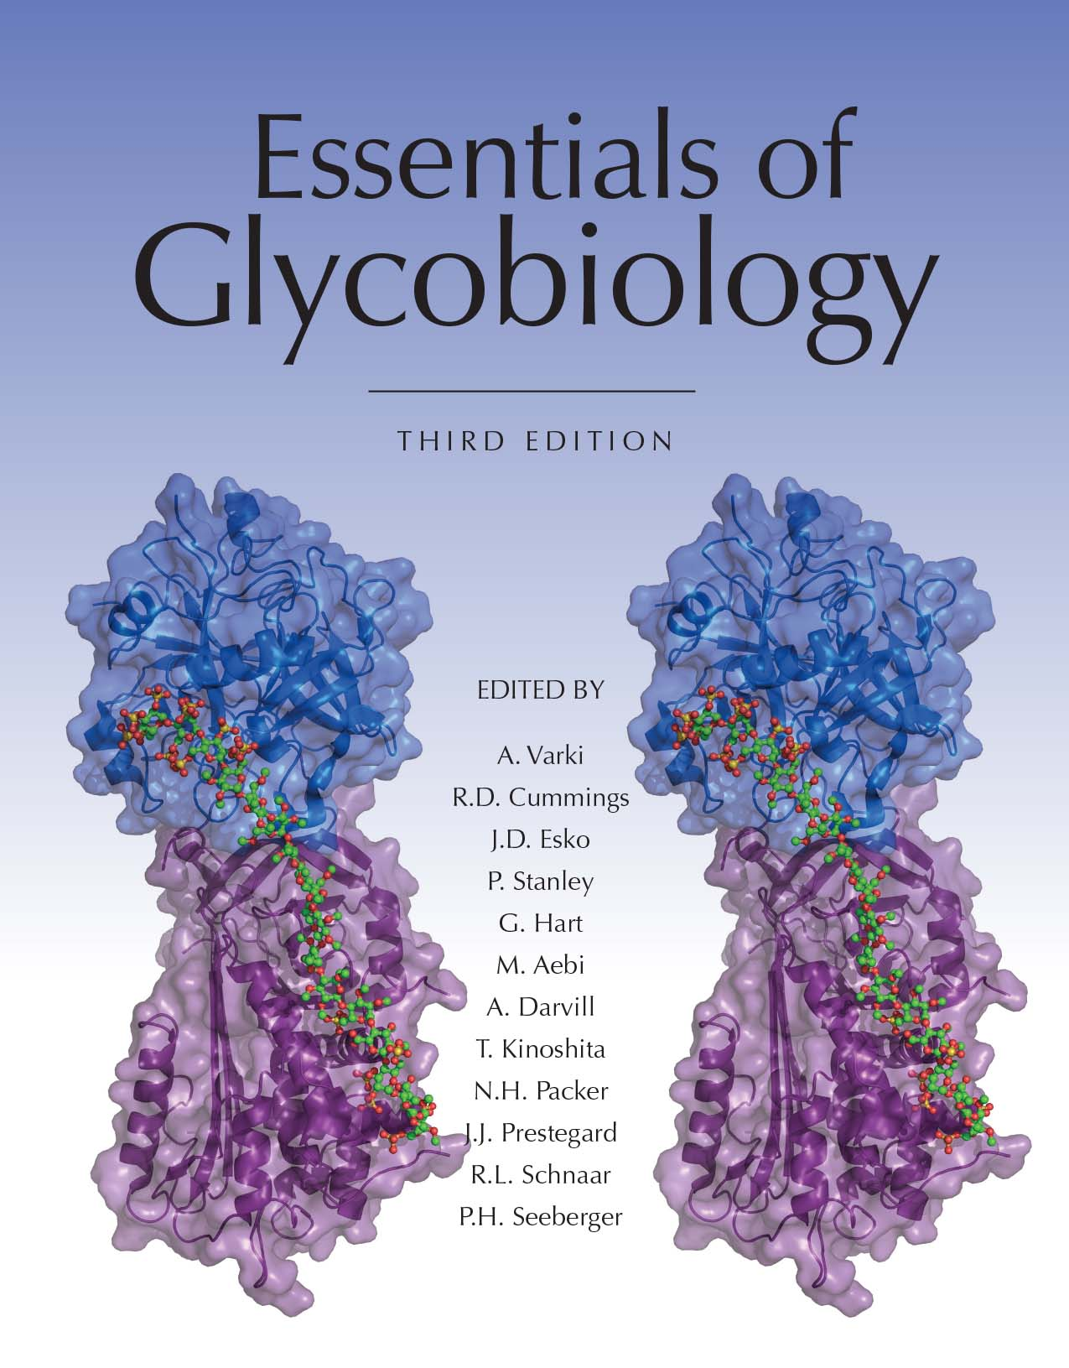
A Calculated Representation of a 2-nm-Sized Gold Glyconanoparticle
Chapter 58, Figure 2. Essentials of Glycobiology, Third Edition
Buy the Book
©2017 The Consortium of Glycobiology Editors, La Jolla, California
Notes:
FIGURE 58.2. A calculated representation of a 2-nm-sized gold glyconanoparticle formed by 102 gold atoms and coated with 44 molecules of 5-mercaptopentyl α-D-mannopyranoside and the corresponding transmission electron microscopy (TEM) image.
(Note: Embedded links are present but live only in the slide display mode.)

