Slide 1
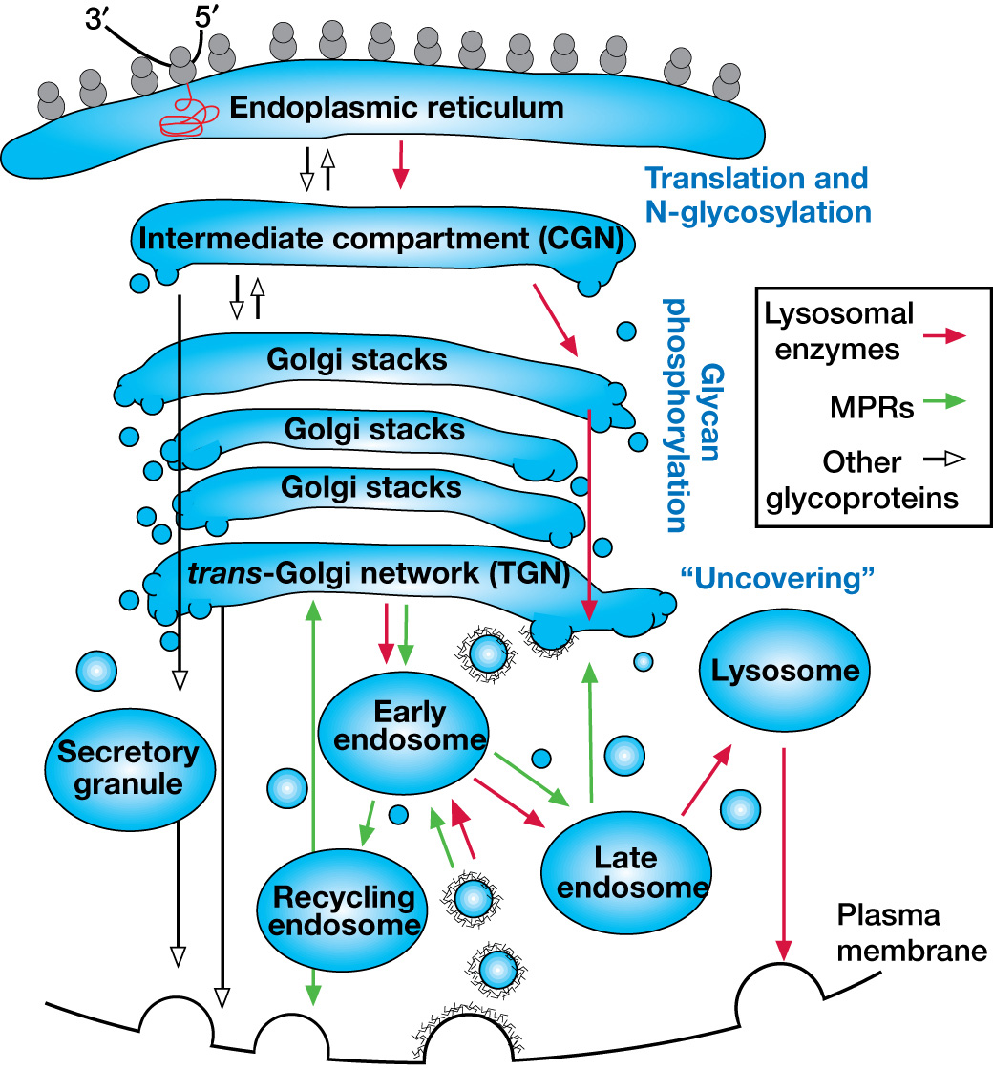



Subcellular Trafficking Pathways of Glycoproteins, Lysosomal Enzymes, and M6P Receptors
Chapter 33, Figure 5. Essentials of Glycobiology, Third Edition
Buy the Book
©2017 The Consortium of Glycobiology Editors, La Jolla, California
Notes:
FIGURE 33.5. Subcellular trafficking pathways of glycoproteins, lysosomal enzymes, and M6P receptors (MPRs). Newly synthesized glycoproteins originating from the rough endoplasmic reticulum (ER) pass through the Golgi stacks and are then sorted to various destinations. Along this route, lysosomal enzymes are recognized by GlcNAc-P-T and phosphorylated in the intermediate compartment (cis-Golgi network) and then acted on by the uncovering enzyme (phosphodiester glycosidase) in the trans-Golgi network (TGN). Beyond the TGN, trafficking of lysosomal enzymes is primarily mediated by the MPRs through early endosomes to late endosomes, in which their lysosomal enzyme cargo is released. Smaller amounts of lysosomal enzymes can escape capture by MPRs and be secreted into the extracellular fluid. Lysosomal enzymes can also reenter the cell by binding to cell-surface MPRs and subsequent endocytosis. Once in the endocytic pathway, internalized lysosomal enzymes can intermingle with those following the biosynthetic route, as depicted. (Open arrowheads) Pathways general to many nonlysosomal glycoproteins; (red arrows) specific itineraries of lysosomal enzymes; (green arrows) pathways of MPRs. Additional pathways for MPRs include recycling from the early endosome to the cell surface and back to the TGN, and from the recycling endosome and the late endosome, following release of their lysosomal enzyme cargo.
(Note: Embedded links are present but live only in the slide display mode.)

