Slide 1
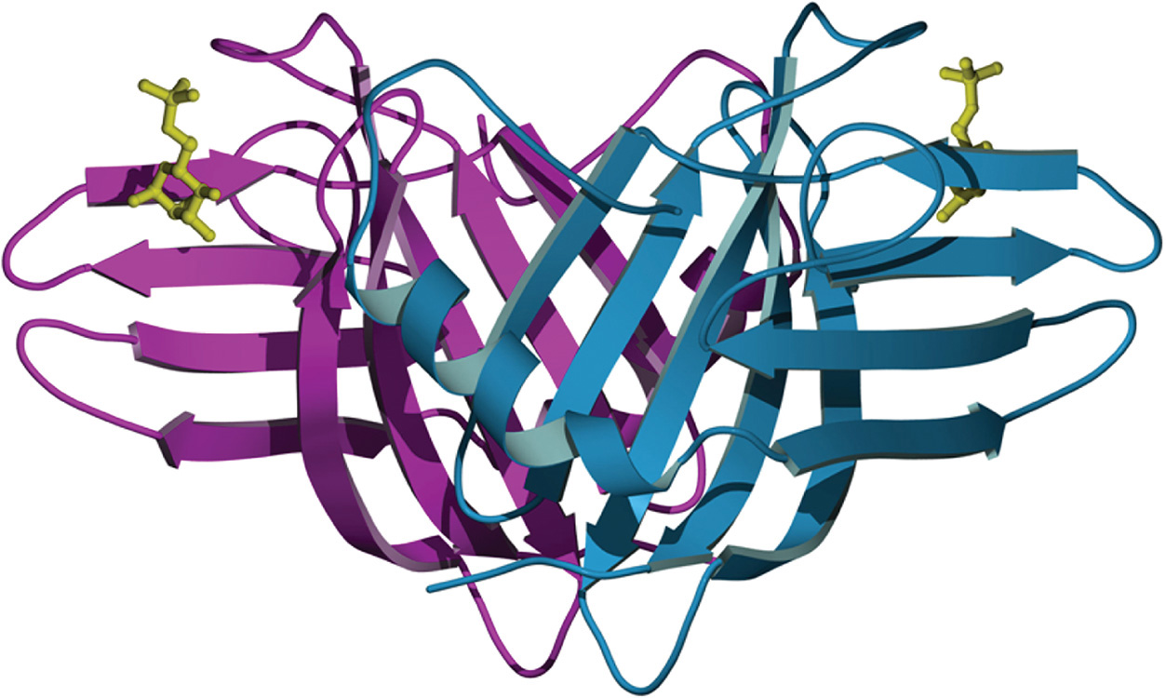



Ribbon Diagram of the Bovine Cation-Dependent M6P Receptor
Chapter 33, Figure 4. Essentials of Glycobiology, Third Edition
Buy the Book
©2017 The Consortium of Glycobiology Editors, La Jolla, California
Notes:
FIGURE 33.4. Ribbon diagram of the bovine cation-dependent M6P receptor (CD-MPR). Shown are the two monomers (magenta and cyan ribbons) of the dimer as well as the ligand M6P (gold ball-and-stick model). (Modified, with permission, from Roberts et al. 1998. Cell 93: 639–648, © Cell Press. Original art has been adapted and redrawn by R.D. Cummings.)
(Note: Embedded links are present but live only in the slide display mode.)

