Slide 1
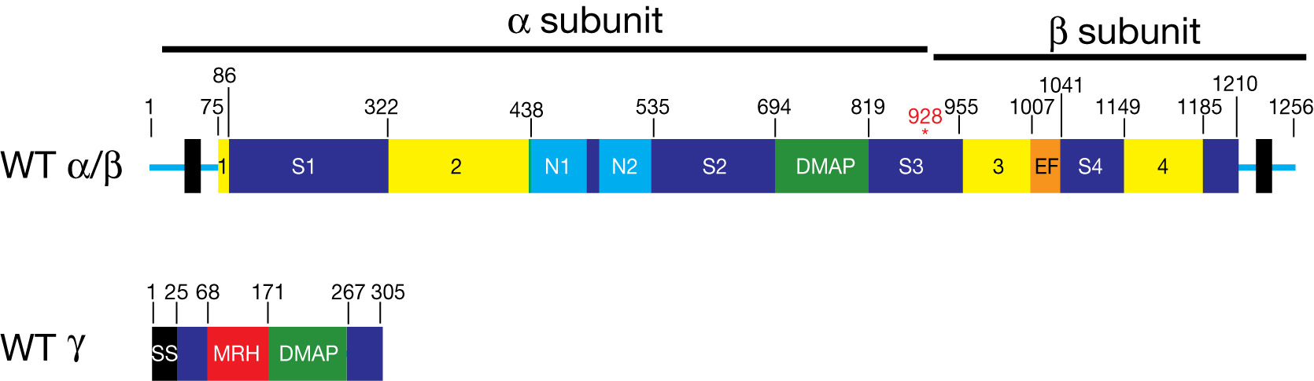


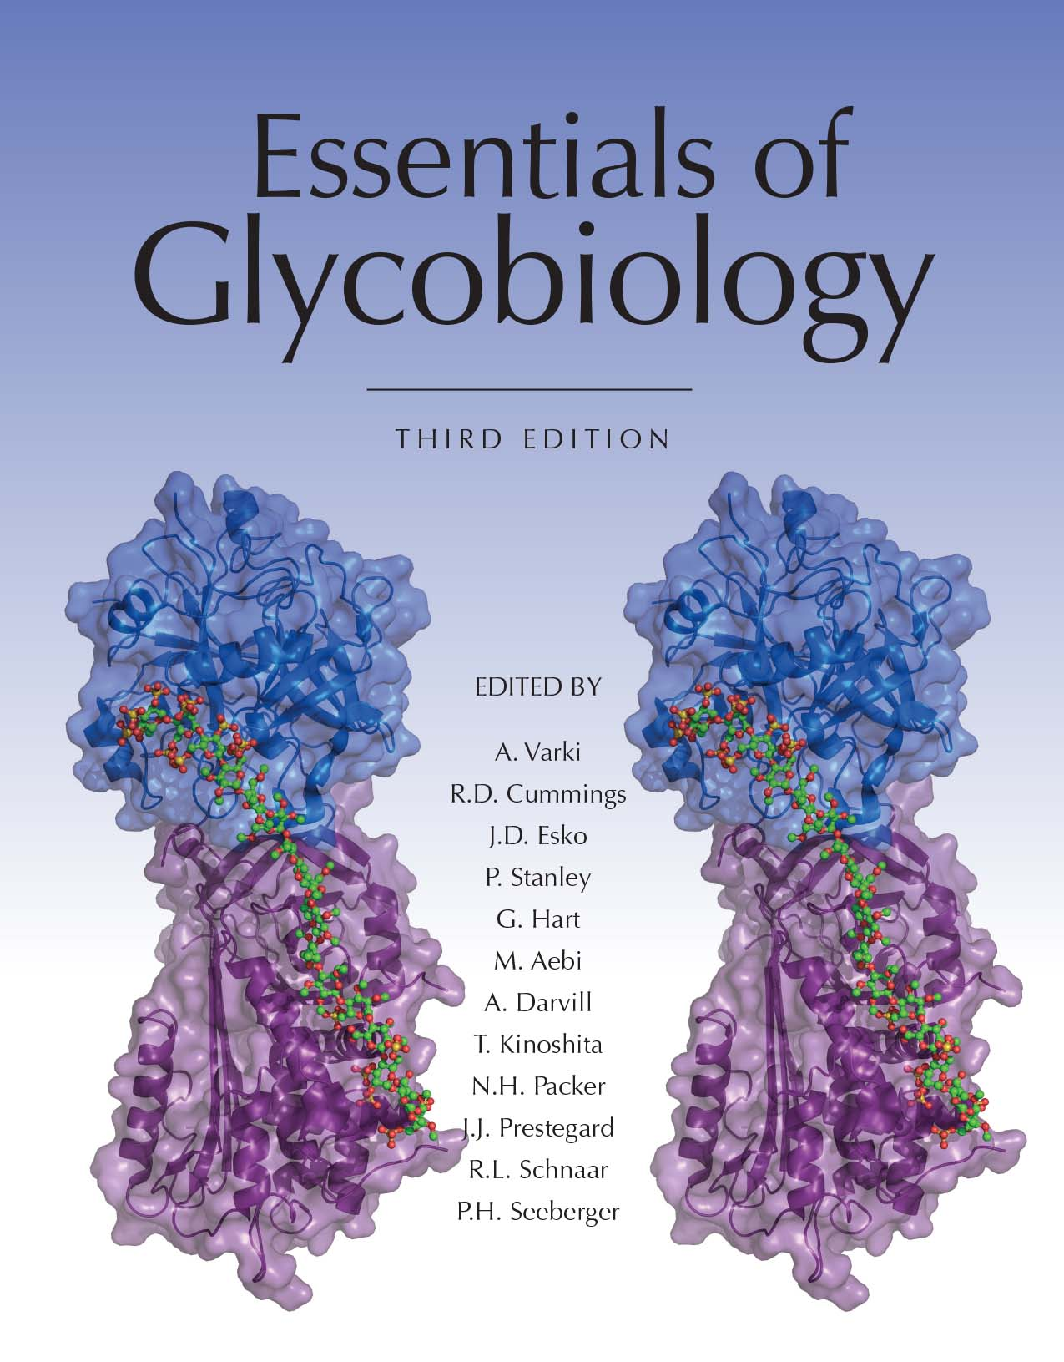
GlcNAc-P-T is an α₂β₂γ₂ Hexamer Encoded by Two Genes
Chapter 33, Figure 3. Essentials of Glycobiology, Third Edition
Buy the Book
©2017 The Consortium of Glycobiology Editors, La Jolla, California
Notes:
FIGURE 33.3. GlcNAc-P-T is an α₂β₂γ₂ hexamer encoded by two genes. The GNPTAB gene encodes a catalytically inactive type 3 transmembrane precursor that undergoes a proteolytic cleavage between Lys-928 and Asp-929 in the Golgi to generate the active α- and β-subunits. These subunits mediate the catalytic function via the Stealth domains (lime-green). These domains are similar to bacterial genes that function as sugar-phosphate transferases in the biosynthesis of cell-wall polysaccharides. The Notch modules (N1,N2) and the DMAP (DNA-methylase-associated protein) domain participate in lysosomal enzyme recognition. The GNPTG gene encodes the γ-subunit that contains a DMAP lysosomal enzyme-binding domain and an MRH (M6P receptor homology) domain that is postulated to bind oligomannosyl N-glycans on lysosomal enzymes and present them to the catalytic site of the transferase. SS, signal sequence; EF, EF-hand calcium-binding motif.
(Note: Embedded links are present but live only in the slide display mode.)

