Slide 1
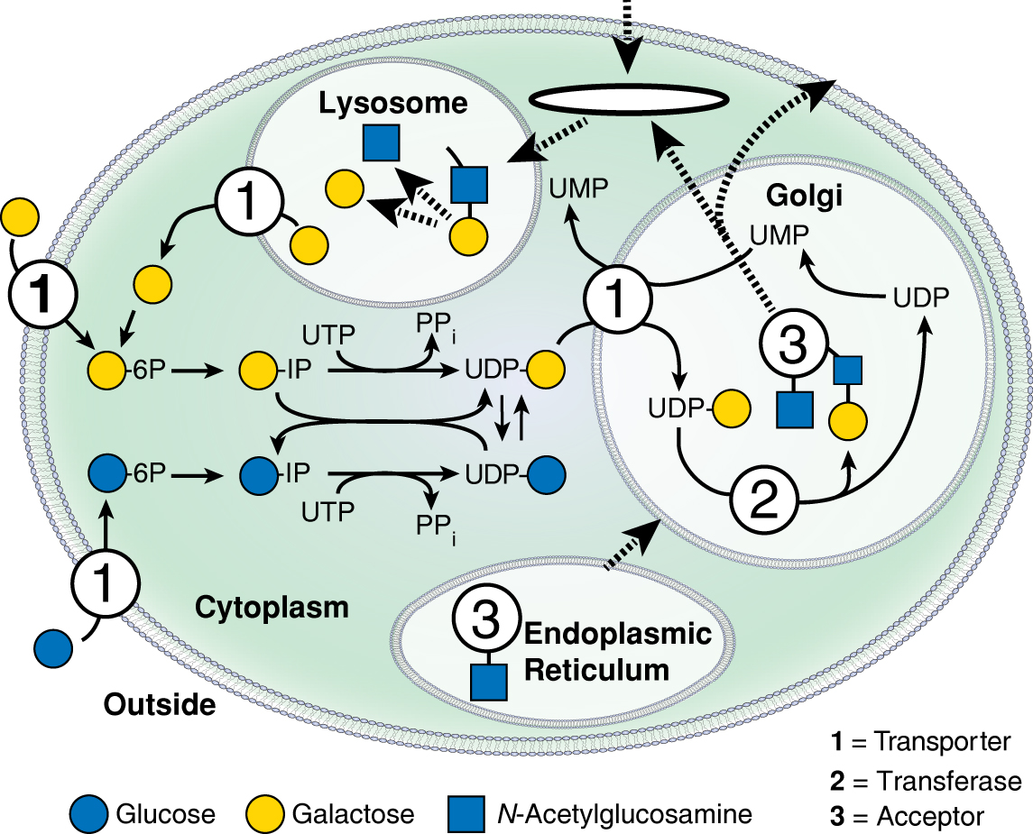
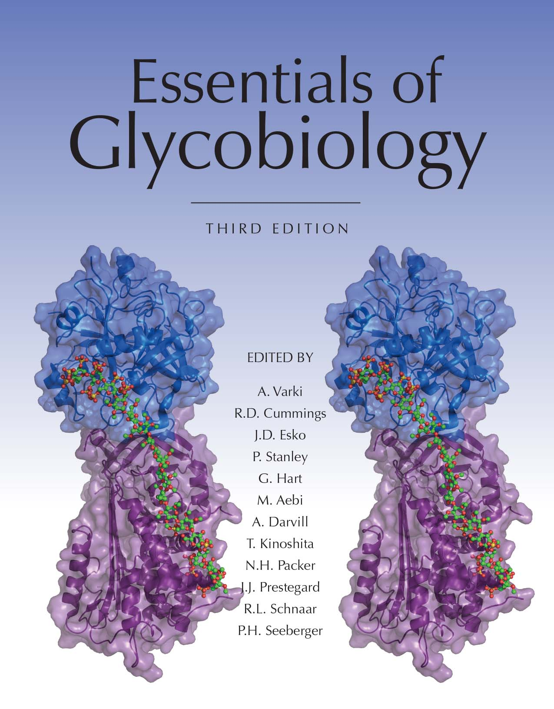
Biosynthesis, Use, and Turnover of a Common Monosaccharide
Chapter 1, Figure 8. Essentials of Glycobiology, Third Edition
Symbol Nomenclature for Glycans (SNFG)
Buy the Book
©2017 The Consortium of Glycobiology Editors, La Jolla, California
Notes:
FIGURE 1.8. Biosynthesis, use, and turnover of a common monosaccharide. This schematic shows the biosynthesis, fate, and turnover of galactose, a common monosaccharide constituent of animal glycans. Although small amounts of galactose can be taken up from the outside of the cell, most cellular galactose is either synthesized de novo from glucose or recycled from degradation of glycoconjugates in the lysosome. The figure is a simplified view of the generation of the UDP nucleotide sugar UDP-Gal, its equilibrium state with UDP-glucose, and its uptake and use in the Golgi apparatus for synthesis of new glycans. (Solid lines) Biochemical pathways; (dashed lines) pathways for the trafficking of membranes and glycans.
(Note: For a key to symbols used for monosaccharides, use the SNFG link. Embedded links are present but live only in the slide display mode.)

